Slide 1





BOSS Initiative
More women contributing to FOSS

Slide 2
Problem

Slide 3
10,3%
of developers are women
according to StackOverflow^{[1]}

Slide 4

3,6%
0,9%
are black developers
are trans people
according to StackOverflow^{[[2][3]}

Slide 5
BOSS

Slide 6
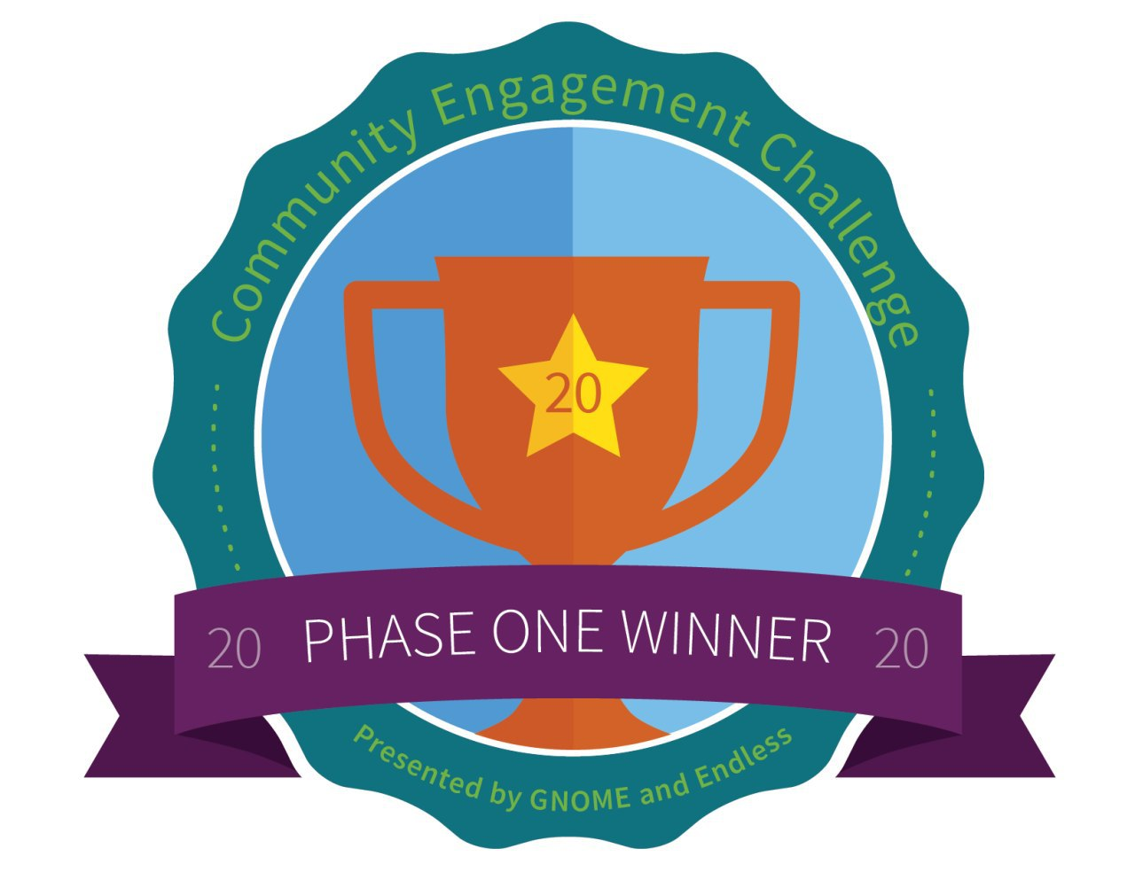
Community engagement challenge
#alternativeText: icon. Trophy for the phase one winners of the community engagement challenge
Link to first phase winners

Slide 7
BOSS - Big Open Source Sister
BOSS aims to reach underrepresented groups in tech who want to be mentored and assisted in learning how to work on open source projects.

Slide 8
Open Source

Slide 9



Free open source software
Proprietary software
#alternativeText: íicon of a Rubik's cube
#alternativeText: silhouette icon of the Rubik's cube

Slide 10









VLC player
Firefox
Gnome
Linux
Blender
Libreflix
Audacity
OBS studio

Slide 11
Barriers
Members non-conforming to stereotypes are submitted to stricter standards^{[4]}
Women have higher incidence of underdog syndrome when talking about software engineering abilities^{[5]}
Micro-aggressions against women in FOSS communities^{[6]}

Slide 12
Project

Slide 13





The project
#alternativeText: icons representing plants phases. Plant seeds, protecting seedlings, growth, and fruits.
Learn about technologies and communities
Contributing to Rasa boilerplate
Learn about Rasa boilerplate and build their own bots
Autonomy to contribute to other FOSS

Slide 14
Structure
Weekly content presentation
Video content
Weekly mentorship
Practices
Pair programming
Link for video presentations
#alternativeText: icons representing the structure of the program. A blackboard, a camera, a pair of people talking to each other, a laptop, and two people with arrows going back and forth.
Link slide presentations

Slide 15
1st milestone of the project
Open source concepts
Git and Gitflow
Issue communications
Software engineer concepts
Open source tools

Slide 16
2nd milestone of the project
Concepts involved in chatbot
Technologies involved in chatbot
Project architecture
Project exploring and discovery
Finding improvements

Slide 17
3rd milestone of the project
Practice
Writing good issues
Contributing with issues
Reviewing other contributors code
Revisando o código de outros contribuidores

Slide 18










Technologies
#alternativeText: icons of: kibana, elasticsearch, TensorFlow, RocketChat, Keras, RASA, API, Python, spaCy e telegram.
Chatbot
Tecnologias

Slide 19
Skills
Remote work
Transparency
Collaboration
Communication
Asynchronous work
Decentralized development
Collective
Versioning
Notes:
Collaboration is an important life skill. But, just as open source is more than just a way to create software, collaboration is bigger than completing tasks more efficiently or being ready for a job.

Slide 20
Talk like a boss

Slide 21
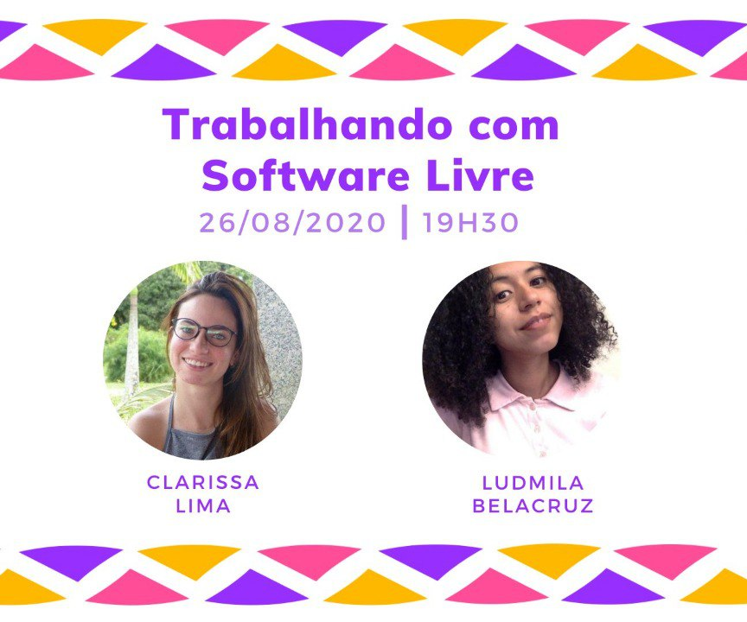

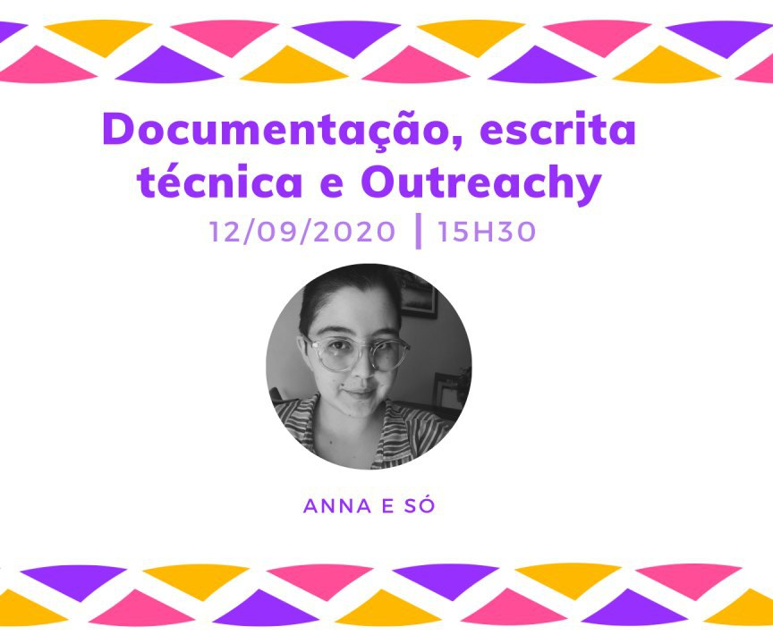
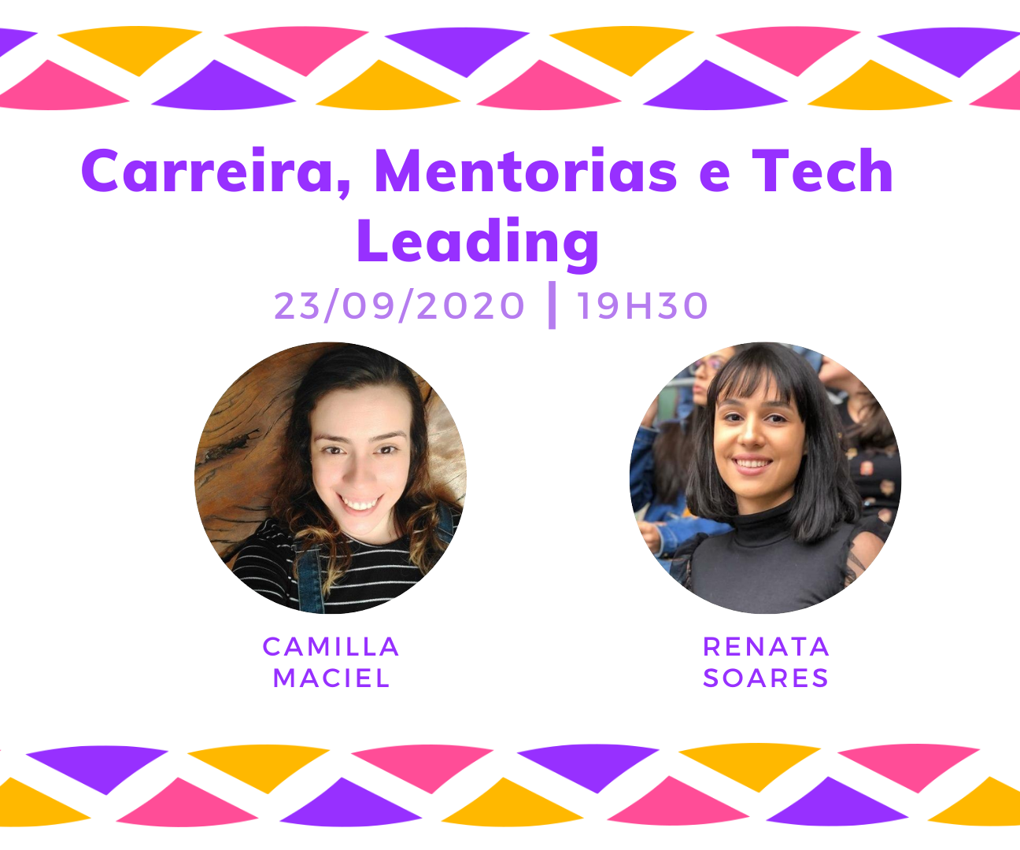
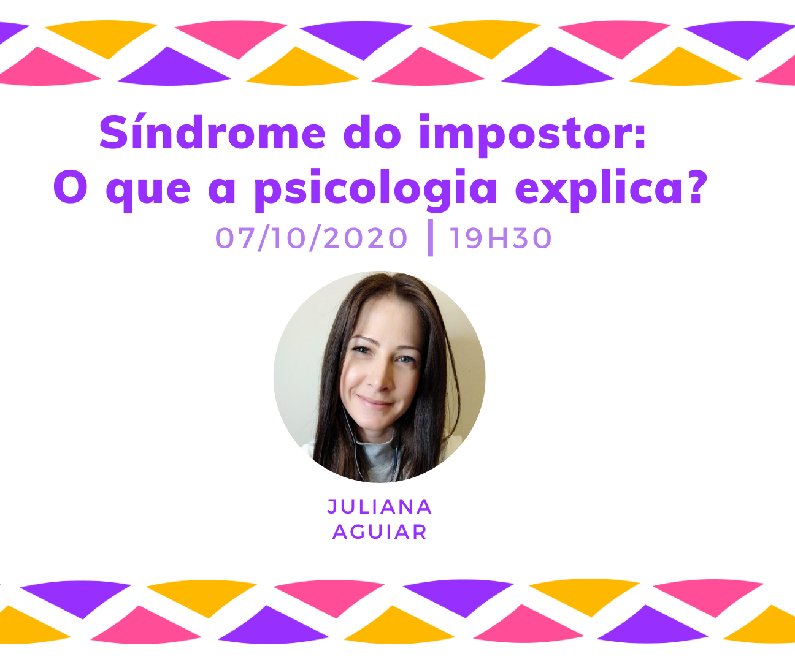
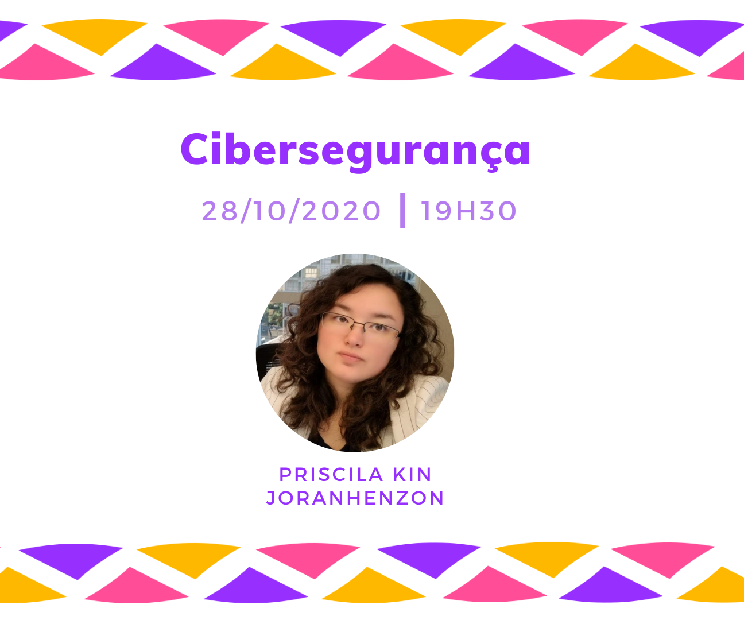
Interviews
Link for interview playlist
#alternativeText: divulgation images. Working with FOSS: Clarissa Lima e Ludimila Belacruz. Participating in coding contests: Giovanna Kobus. Documentation, technical writing, and Outreachy: Anna e só. Tech Lead, mentoring and career: Camilla Maciel e Renata Soares. Impostor syndrome: Juliana Aguiar. Cybersecurity: Priscila Joranhezon.

Slide 22
Interview series
Professionals of different areas
Community questions
Community suggested themes
Talk like a boss
Not only technical talks
Participants writing scripts for the interview
Participants doing interviews

Slide 23
Organization

Slide 24
0st milestone of the project
Mentoring training
Good practices
Overview of the program

Slide 25
The project
#AlternativeText icons. Three people connected for meetings. Written page and a pencil for issue description. Pencil and ruler for content presentation. Two people talking for mentorship feedback.
Organization meetings
Issue description
Content presentation
Mentorship feedback

Slide 26
End of the program

Slide 27

Celebration
Gather participants
Present contributions
Celebrate journey
Play
Eat
#alternativeText: Illustration. Three people jumping with hands in the air celebrating. In the background there are confetti and balloons.

Slide 28

Thanks
Everyone who believed, helped and learned in this journey.
#alternativeText: Illustration. Five people connected. In the background, the world is spinning.
bigopensourcesister@gmail.com
https://github.com/orgs/BOSS-BigOpenSourceSister

Slide 29
License
This presentation is under The Creative Commons License. creativecommons.org/licenses/by-nc-sa/3.0/

Slide 30
References
[1]: https://insights.stackoverflow.com/survey/2020#developer-profile-gender-gender-minorities-by-country
[2]: https://insights.stackoverflow.com/survey/2020#developer-profile-race-and-ethnicity
[3]: https://insights.stackoverflow.com/survey/2020#developer-profile-transgender
[4]: https://dl.acm.org/doi/10.1109/ICSE.2019.00078
[5]: https://dl.acm.org/doi/10.1109/GE.2019.00008
[6]: https://dl.acm.org/doi/10.1109/ICSE.2019.00077

Slide 31
More references
Illustrations: https://stories.freepik.com/
Gnome engagement challenge: https://www.gnome.org/challenge/
BOSS on youtube: https://www.youtube.com/channel/UCQxKAvq-QLq57dqGYI_TuFw

